Slide 1
Secure Multi-Region Hub-and-Spoke Microservices Architecture on AWS

Slide 2
The main Problem
How do we securely run a highly available application
across multiple environments (VPCs)
with centralized security and disaster recovery
without exposing internal services to the internet?

Slide 3
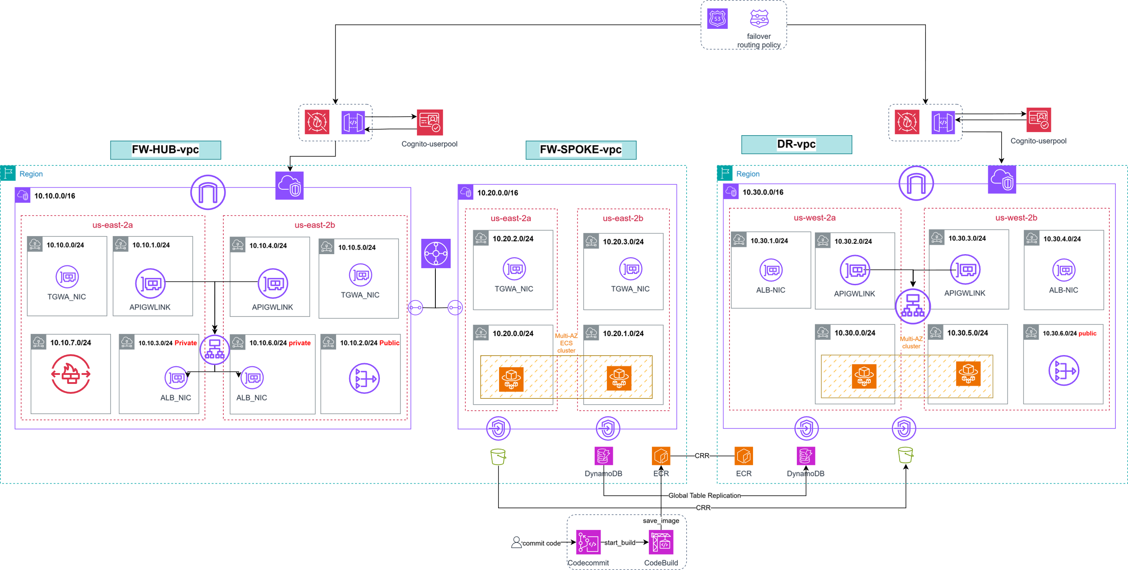
The full Architecture

Slide 4
Key Technical Challenges
Pt. 1
Standardized, Portable, and Independently Scalable Application Deployment
Applications fail under traffic spikes without automatic scaling
Security is scattered and hard to control
Exposing services publicly increases risk
Entire region failure = total outage

Slide 5
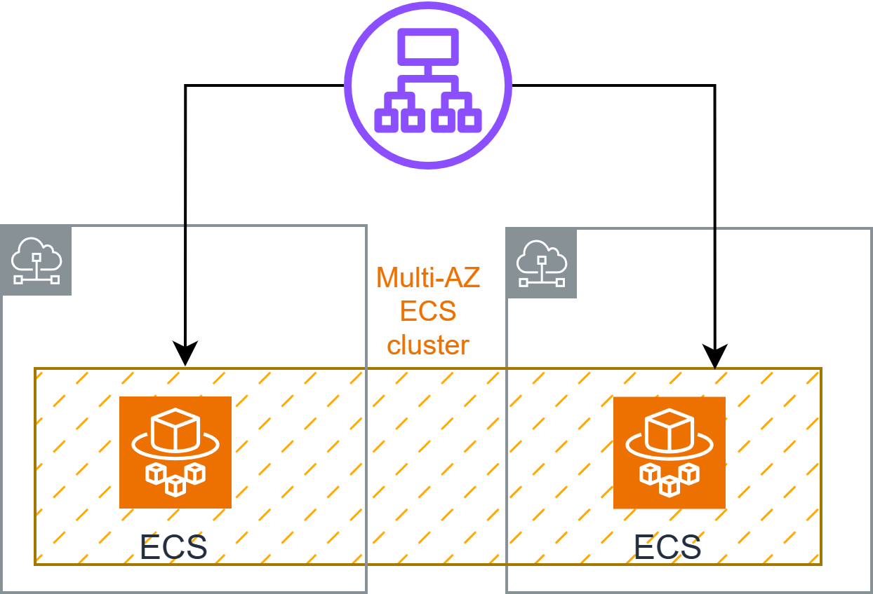
ALB & ECS

Slide 6
Key Technical Challenges
Pt. 1
Standardized, Portable, and Independently Scalable Application Deployment
Applications fail under traffic spikes without automatic scaling
Security is scattered and hard to control
Exposing services publicly increases risk
Entire region failure = total outage

Slide 7
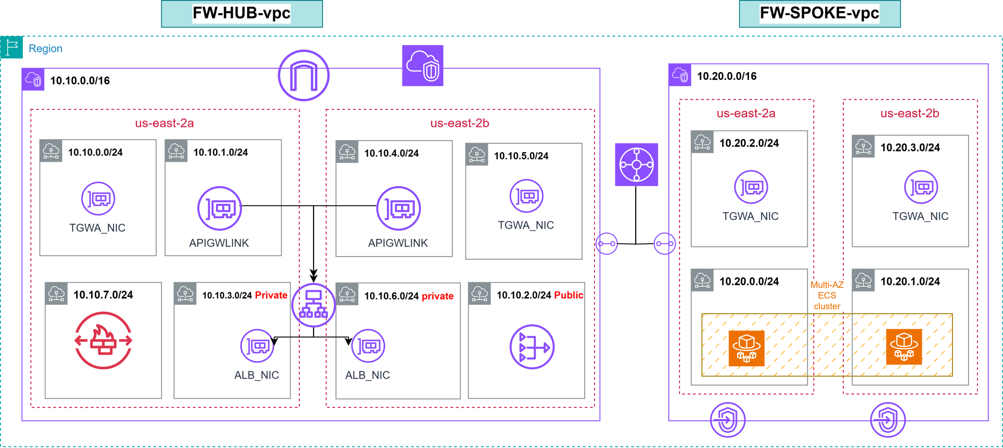
HUB & SPOKE

Slide 8
Key Technical Challenges
Pt. 1
Standardized, Portable, and Independently Scalable Application Deployment
Applications fail under traffic spikes without automatic scaling
Security is scattered and hard to control
Exposing services publicly increases risk
Entire region failure = total outage

Slide 9
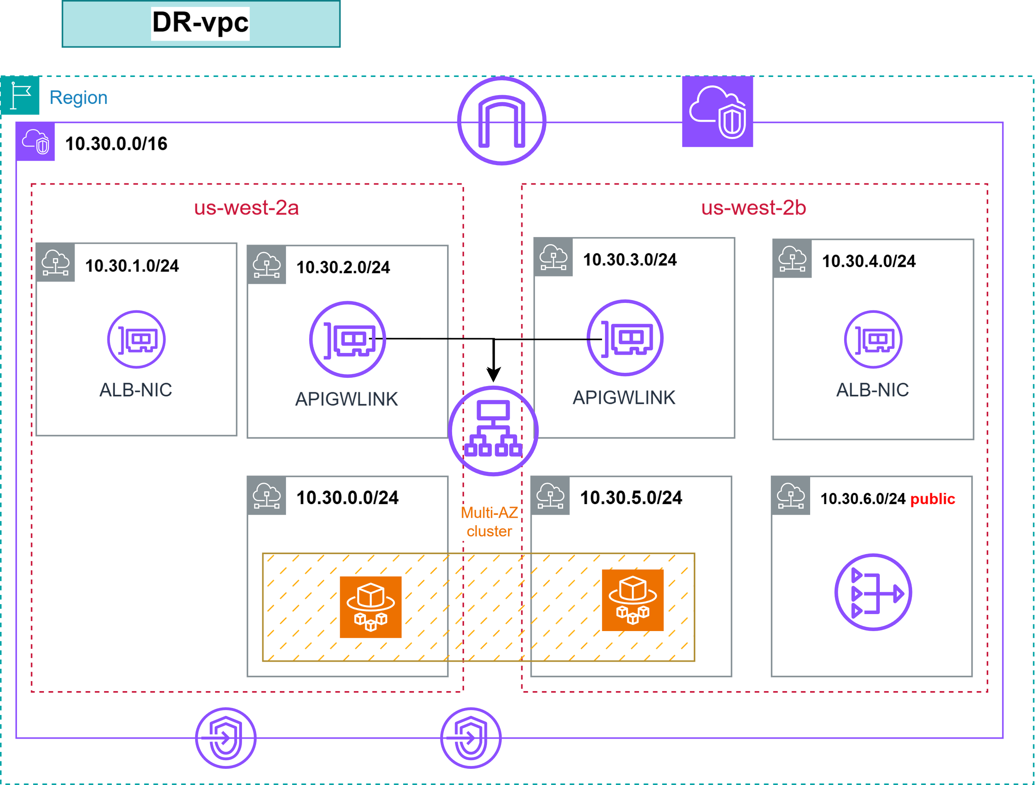
Disaster Recovery

Slide 10
Key Technical Challenges
Pt. 1
Standardized, Portable, and Independently Scalable Application Deployment
Applications fail under traffic spikes without automatic scaling
Security is scattered and hard to control
Exposing services publicly increases risk
Entire region failure = total outage

Slide 11
Data inconsistency across regions
Request management & control
Direct service-to-service communication becomes difficult to manage at scale
the need to Decouple clients from services
Achieving Release Governance by decoupling immutable artifact creation from orchestrated deployment through a Manual Approval Gate
Key Technical Challenges
Pt. 2

Slide 12
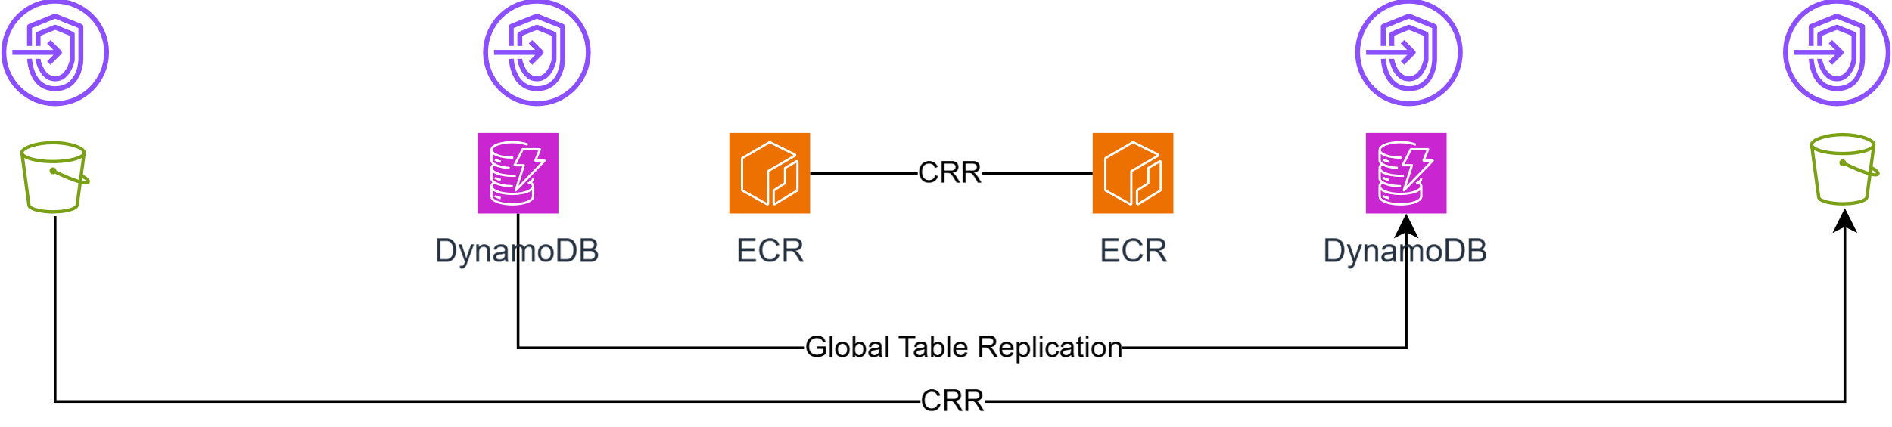
Data Replication

Slide 13
Data inconsistency across regions
Request management & control
Direct service-to-service communication becomes difficult to manage at scale
the need to Decouple clients from services
Achieving Release Governance by decoupling immutable artifact creation from orchestrated deployment through a Manual Approval Gate
Key Technical Challenges
Pt. 2

Slide 14
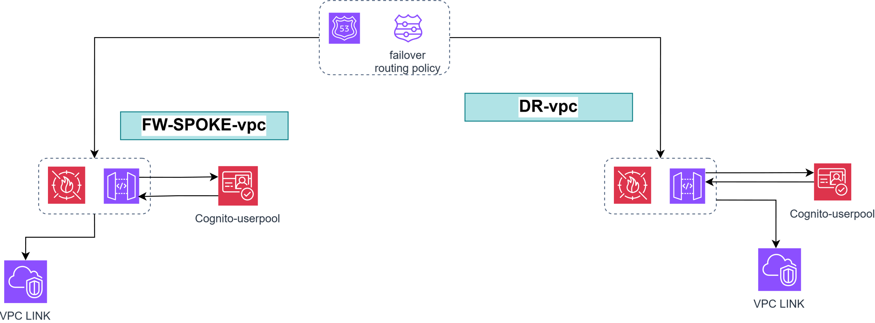
The front door

Slide 15
Data inconsistency across regions
Request management & control
Direct service-to-service communication becomes difficult to manage at scale
the need to Decouple clients from services
Achieving Release Governance by decoupling immutable artifact creation from orchestrated deployment through a Manual Approval Gate.
Key Technical Challenges
Pt. 2

Slide 16
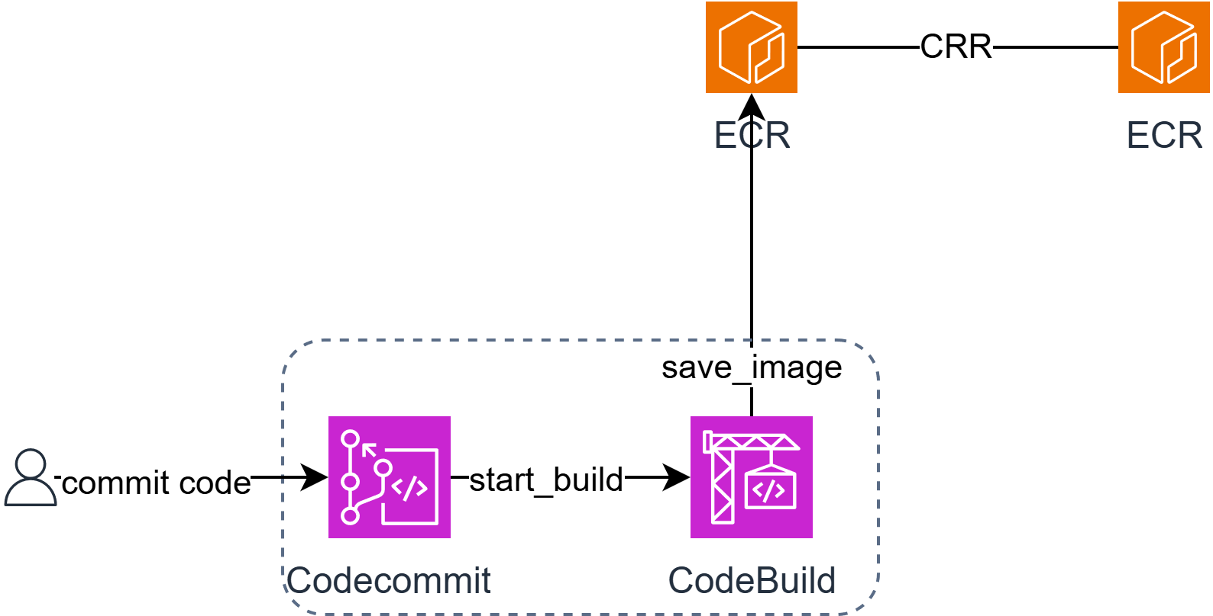
Governed Release

Slide 17
Data inconsistency across regions
Request management & control
Direct service-to-service communication becomes difficult to manage at scale
the need to Decouple clients from services
Achieving Release Governance by decoupling immutable artifact creation from orchestrated deployment through a Manual Approval Gate.
Key Technical Challenges
Pt. 2

